Slide 1
Jermyn Borough Council Meeting
11/20/2025

Slide 2

Meeting Agenda
November 20, 2005
• CALL TO ORDER
• PLEDGE OF ALLEGIANCE
• ROLL CALL
• PREVIOUS MEETING MINUTES
• TREASURE REPORT/BILLS PAYABLE
• CORRESPONDENCE
• SECRETARY REPORT
• PUBLIC COMMENT
• PROFESSIONAL REPORTS
• COMMITTEE REPORTS
• COLIN STRIEFSKY
• LSA GRANT RESOLUTIONS
• 2026 BUDGET
• REASSESSMENT MILLAGE
• R&L TRUCKING
• NEW BUSINESS
• ADJOURNMENT

Slide 3
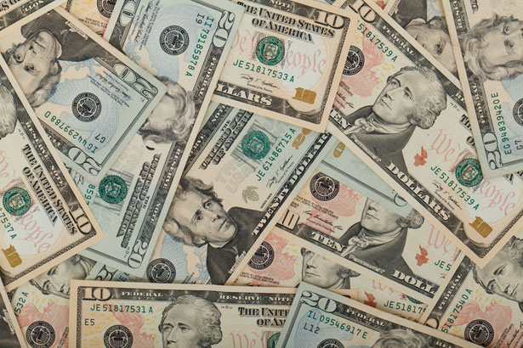
Treasurer’s report
11/20/2025
ASSETS
Checking/Savings
American Rescue Plan Fund 92,601.08
Capital Reserve - DPW 1,207.95
Capital Reserve - Police 7,049.82
Crime Watch Fund 222.69
General Fund - Community 135,785.76
General Fund - FNB 4,697.69
Holiday Lights Fund 400.59

Slide 4
Treasurer’s report
Investment - General Fund 1,161.83
Investment - Liquid Fuels 25,580.80
Investment - Paving Fund 1,173.90
Investment - Recycling 128.28
Investment - Refuse 182.95
Liquid Fuels - FNB 26,498.51
Petty Cash 194.00
Recreations Fund 19,794.92
Recycling - Community 9,369.64
Refuse Checking - FNB 162,303.29
Total Checking/Savings 488,353.70

Slide 5
Treasurer’s report
200000 · Accounts Payable 14,819.23
Long Term Debt 0

Slide 6


